Slide 1
Identifying Transmembrane Helices in Tertiary Structures
SSBI – Project 3
Marco Klein, Julian Späth, Julius Vetter

Slide 2
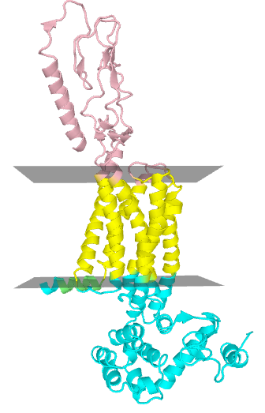
Transmembrane (TM) Proteins
Perform many important physiological tasks
Molecule transport
Cell signaling
Contained substructures
Helix bundle
Beta barrel

Slide 3
Motivation & Goal
Only few determined tertiary structures
PDB entries have no information on membrane topology
Calculate Membrane Geometry
PDB
Entry
Is helix TM?
Helices
TM
Helices
Classifier

Slide 4
Data Processing
PDBTM Database
Annotates transmembrane regions in proteins
Find overlap between
Annotated TM regions (PDBTM)
Helix regions (PDB)
Overlap ≥ 70% → positive samples = 0% → negative samples
Additional neg. samples from globular proteins

Slide 5
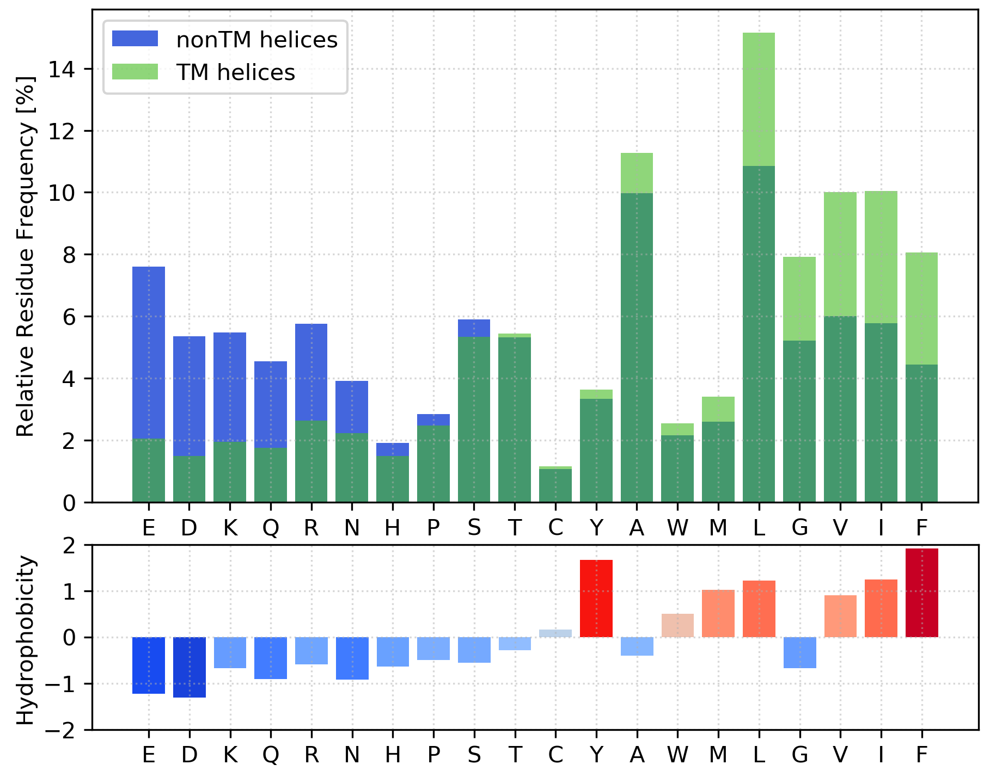
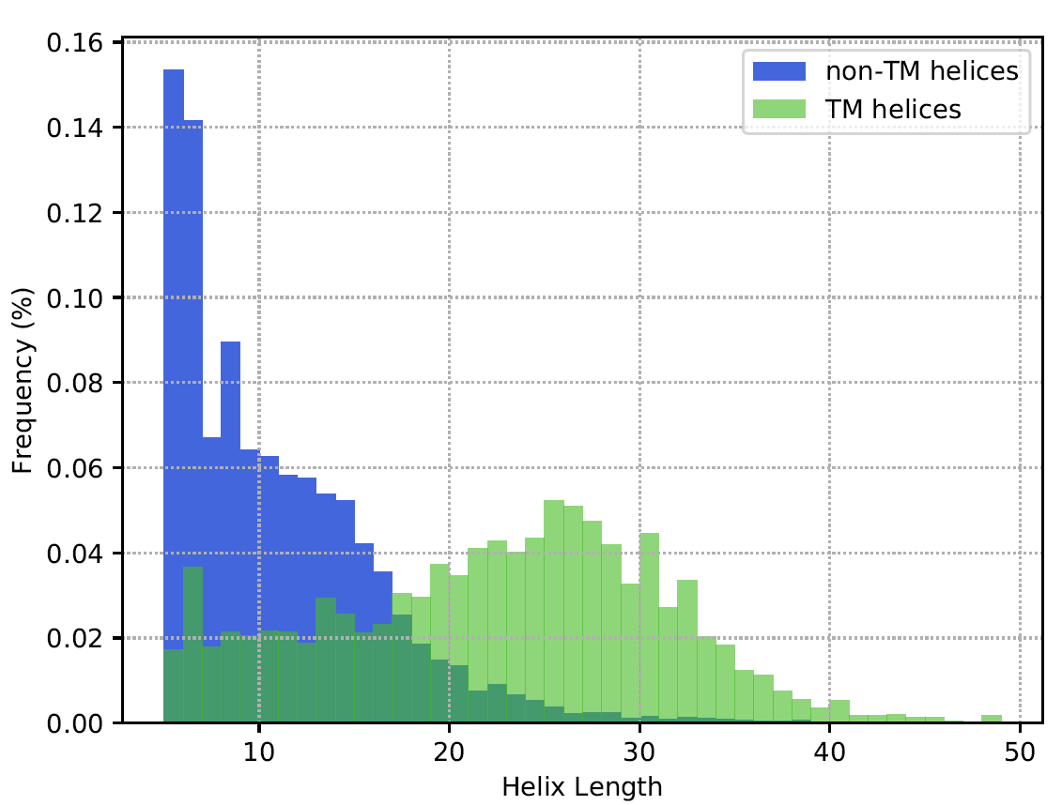
Differences TM vs non-TM
Amino Acid Composition
Helix length

Slide 6
Helix Classification
Brauchen wir die Confusion matrix überhaupt? Macht es nur mehr bloated,
Sn/SP/MCC sind viel kompakter
70% training data, 30% test data
Features: Amino acid counts
Classifiers: linear & rbf kernel SVM
rbf kernel SVM |  | Reality
 |  | TM | non-TM
Predicted | TM | 10016 | 569
 | non-TM | 405 | 14027
Sn = 0.96
Sp = 0.96
MCC = 0.92

Slide 7
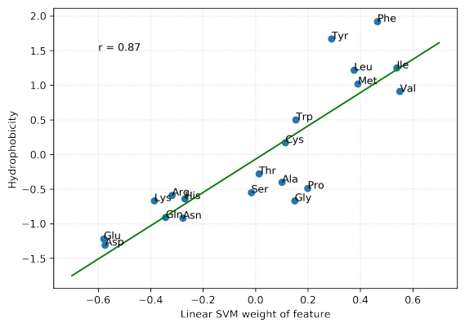
Linear SVM weights
SVM learned hydrophobicity measure without prior knowledge

Slide 8
Membrane geometry calculation
Preliminary geometry
Filter potential FP helices via angle and distance cutoffs
Remaining helices
→ first PCA loading vector = Membrane normal
Optimisation
Objective function: Q-value
Sample test vectors in cone around normal vector
Take vector with highest Q-value

Slide 9
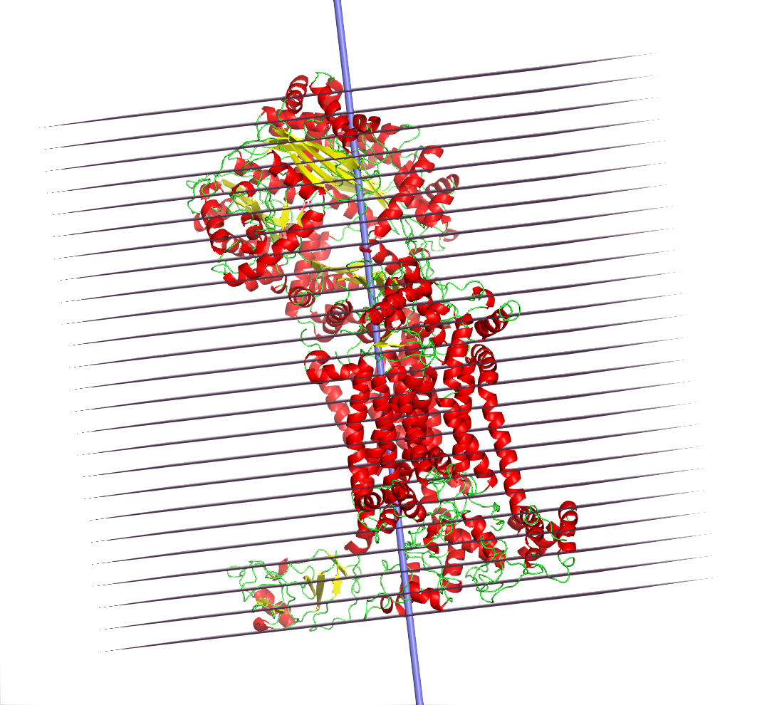
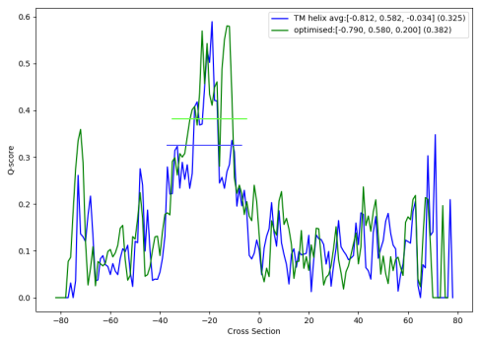
Membrane geometry calculation
Divide tertiary structure in slices
Calculate hydrophobic and geometric factors

Slide 10
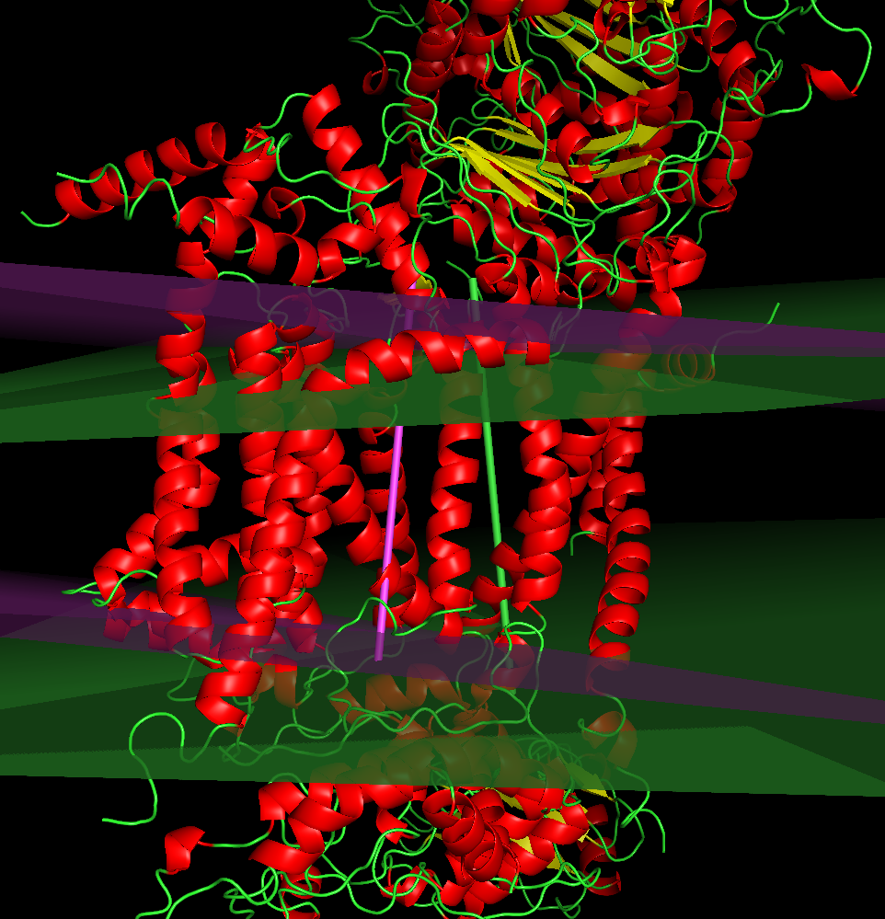
Optimisation result

Slide 11
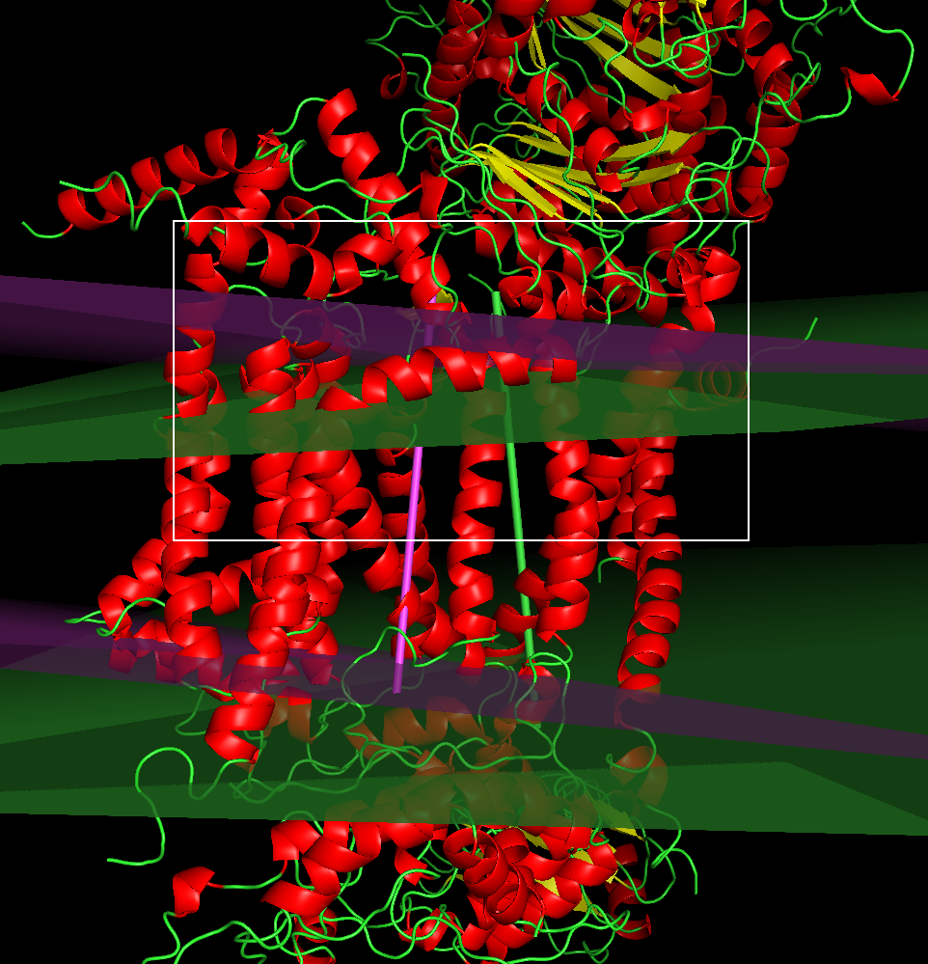
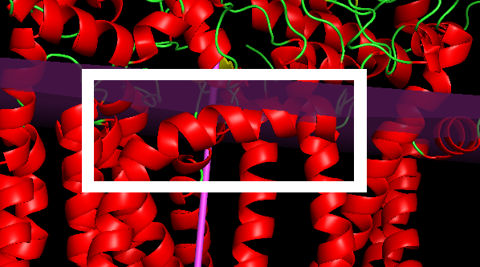
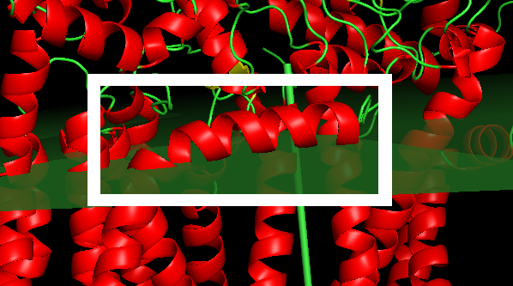
Optimisation result
Before
After

Slide 12
False Positive Removal
Angle and distance criteria seem to filter False Positive helices quite reliably
This could be applied to refine the results of the classifier for better prediction performance

Slide 13
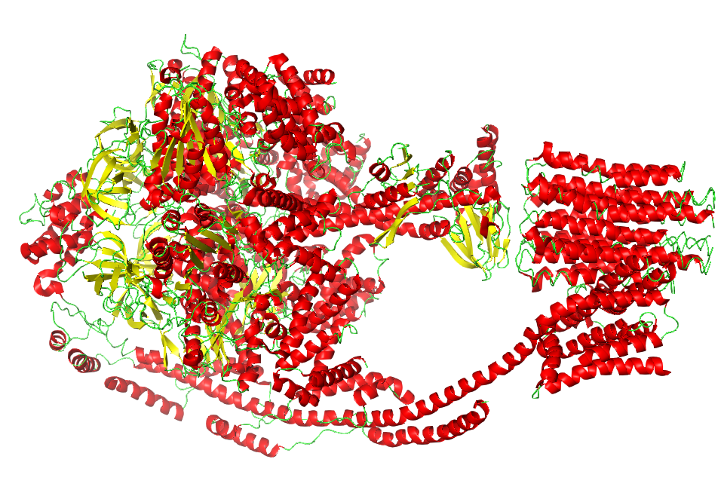
Protein 5ARH
(ATP synthase)

Slide 14
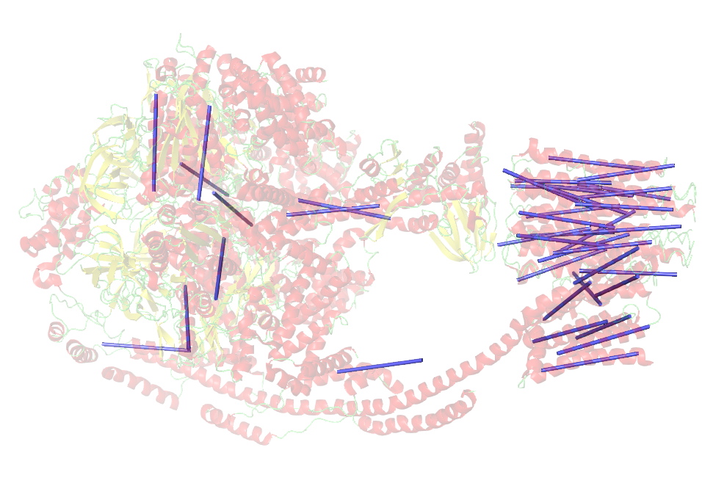
Helices classified
as transmembrane

Slide 15
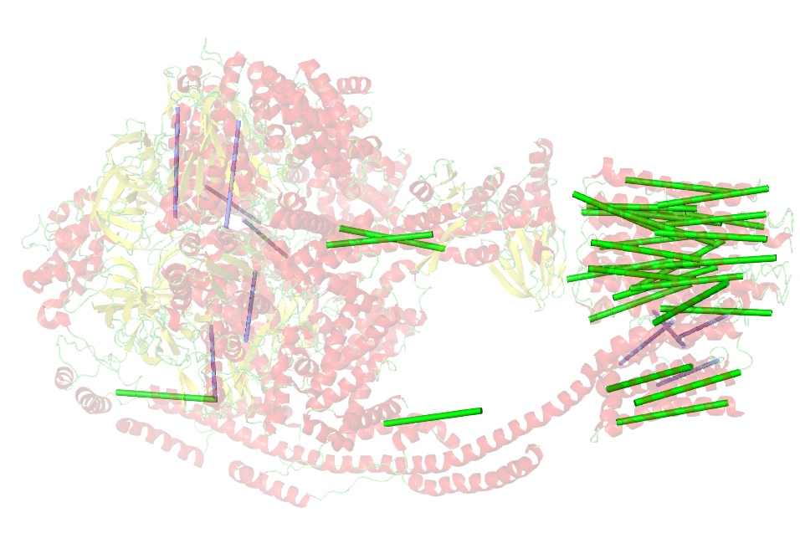
Filter 1:
by angle

Slide 16
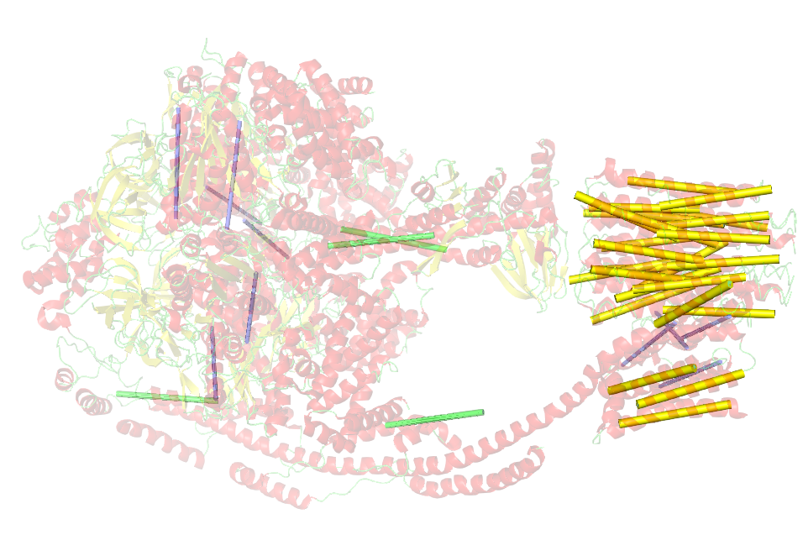
Filter 2:
by distance

Slide 17
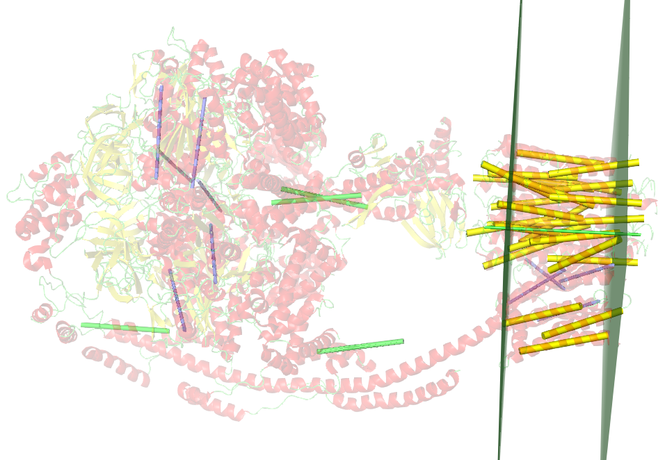
Membrane
calculation

Slide 18
Scores for non-TM proteins
Globulin -> 0.169
Hexokinase -> 0.162

Slide 19
Thank you for your attention!

